Slide 1
Avoiding a Scam When You’re Looking for a Job
First name Last name | Date
Notes:
Notes:
[Greet the audience and introduce yourself.]
Today, we’ll be talking about ways to spot and avoid scams while you’re looking for a job.
NOTE TO PRESENTERS:
You don’t have to cover all the issues in this PPT.
We recommend you pull out only the things you want to cover, considering the audience and length of time given for the presentation.
If you want to use all of the slides, we estimate the full presentation will run approximately 15 minutes.
Also, you don’t have to use the notes verbatim. We offer them as a foundation.
The information was pulled from existing vetted materials.

Slide 2
Who the FTC Is and What It Does
Enforcement
Consumer and Business Education
Building Partnerships and Coalitions
Notes:
Notes:
First, let me tell you a little bit about the FTC. As the nation’s consumer protection agency, the FTC works to stop fraud, deception, and unfair business practices. This is done in several different ways.
Through enforcement, the FTC does investigations, sues companies and people that break the law, and tries to get money back to people whenever possible.
Many of those cases are based on the reports the FTC gets from people just like you, who talk about the scams and dishonest practices they see – even if they don’t lose money.
Through education and outreach, the FTC tells people about their rights and businesses about their responsibilities
In print, online, and in person (or virtually), the FTC shares how to spot and avoid scams, how to report them, and how talking about a scam – with anyone – helps protect not just yourself but also your network.
Finally, the FTC can’t do it alone. By working with groups from libraries and community advocates to state and federal agencies, the FTC tries to amplify the message and reach a broader audience.

Slide 3
Before You Start a Job Search
Spot ads for fake job or business opportunities
Common job scams
Money-making scams
Spot job scams by how they pay
How to avoid scams
Report scams
Notes:
Notes:
There are lots of reasons you might be looking for a job — now or in the future. Whether you’re entering the workforce or switching jobs, looking for work is a full-time job. And as you start the search, knowing about the scams that target job seekers will help you spot and avoid the scammers.
Today, we’ll cover:
How to spot ads for fake job opportunities
Examples of common job scams
Money-making scams
Another way to spot job scams by how they pay
How to avoid job scams, and
How to report scams

Slide 4
Ads for Fake Job or Business Opportunities
Work from home
Make your own hours
Make thousands in just a few hours a day
Notes:
Notes:
These are samples of fake job ads. The wording may change, but scammers always make big promises that simply aren’t real, like you’ll get rich working just a few hours a day. And they’ll demand sensitive information like your Social Security number before they hire you. If you give it to them, they could wind up stealing your identity.
Other job listings may ask you to pay for training or certification that are fake, unnecessary, or both. Don’t pay upfront for training or certifications.
**And if there’s only one thing you remember from today’s presentation, this is it: anybody who charges you for a job is a scammer.

Slide 5
Common Job Scams
Work from home job scams
Impersonators
Notes:
Notes:
Let’s look at a couple of examples of job scams. The details can change, but these are some of the scams we’re hearing about regularly:
Working from home is more common these days. Scammers know that and are posting ads offering online jobs. They’ll say you can make money doing something like entering data, or as a virtual assistant, or a mystery shopper. Often, they’ll say you can make loads of money in a short time — which we already know is a sign of a scam.
Scammers will often pretend to be someone they’re not, posting fake ads that offer positions that don’t exist. These phony job opportunities come from what you think are well-known employers, and they can offer great pay, flexible hours, training, telework options, and money to set up a home office. It can be tricky to tell what’s a real job and when they’re just after your money or personal information. But in just a minute we’ll talk about other ways to spot the scams.

Slide 6
Money-making Scams
Fake coaching programs
Dishonest invention promoters
Fake business opportunities
Notes:
Notes:
We also see scams around other ways to make money, for things that look like real business offers. For example, some of these include:
business coaching programs that promise to give you secrets to success
help promoting your invention to market your idea, but don’t deliver what was promised
and opportunities that say you can make lots of money selling products from home, but the products turn out to be junk or very hard to sell.
These opportunities can look real, but if anyone guarantees that you’ll make a lot of money or that you’ll be successful, you can bet that’s a scam. In business, there are no guarantees, and that’s one way to spot a scam.
What we see often is that eventually, most people find that no matter how hard they work, they can’t sell enough inventory or recruit enough people to make money. They also can’t make enough money to cover the expenses and have to quit, losing everything they invested.

Slide 7
Spot Job Scams by How They Pay
+
=
“Send me some of the money”
“Deposit this check”
Scam
Notes:
Here’s another way to spot a job scam. If anyone gives you a check, tells you to deposit it, and then send money back, that’s a scam.
Here’s how it can play out: Your supposed boss might send you a check for several thousand dollars — maybe to get a computer, office equipment, or products for you to try and review. Whatever their reason, they then ask you to deposit the check and then send them part of the money. That’s where the alarm bells go off. Because that check is fake, by the time the bank realizes it, the scammer has your money. The bank will want you to repay them whatever you send to the scammer, too. And that job you thought you had? You probably don’t have that, either.
Remember: Honest employers won’t send you a check and ask you to send part of the money.

Slide 8
How to Avoid Job Scams
Don't pay for the promise of a job
Do your own research
Take your time
Notes:
Notes:
Now that you know more about how these scams work and how to spot them, here are some ways to avoid them:
Never pay for the promise of a job. Honest employers, including the federal government, will never ask you to pay to get a job. Anyone who does is a scammer.
Do some research. Search online for the name of the company or the person who’s hiring you. Add the words “scam,” “review,” or “complaint” to your search. See what others are saying. You might find out they’ve scammed other people.
Also, check out the company’s “careers” or “job opportunities” section. Go directly to the site instead of clicking a link that someone sends, which could take you to a scam site. If the same position isn’t listed on the real site, walk away. If it’s there, apply directly through the organization’s website, if you can. And finally,
Take your time. Talk to someone you trust and describe the offer to them. Ask what they think. Just explaining the offer to someone else will give you more time to think about it.

Slide 9
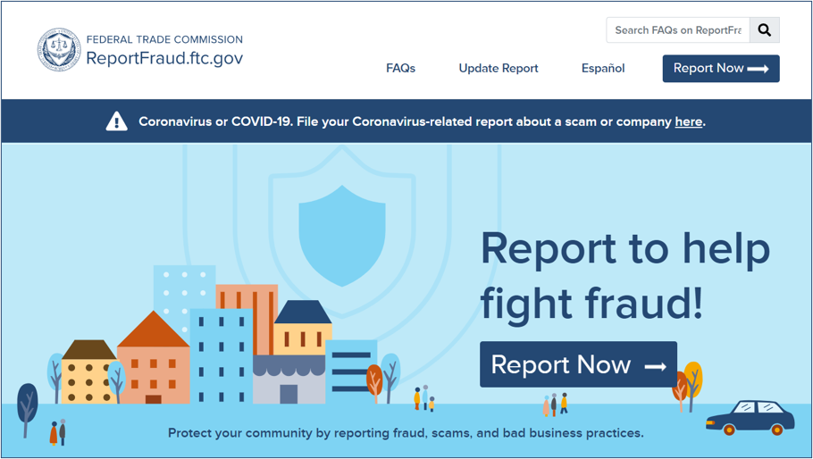
Report Fraud to the FTC
English:
ReportFraud.ftc.gov
Spanish:
ReporteFraude.ftc.gov
Notes:
Notes:
This is what the site looks like when you report a scam.
The FTC uses reports to investigate and bring law enforcement cases. Reports also help the FTC know what scams to alert people about, so they can protect themselves, their friends, and family.
When you follow a few short steps at ReportFraud.ftc.gov, your report is instantly available to more than 3,000 federal, state, and local law enforcers across the country. And, once you tell the FTC what happened, you’ll get advice on what to do to recover and how to guard against fraud in the future.

Slide 10
Get and Share FREE Resources
Spot other job scams: ftc.gov/jobscams
Learn about scams: consumer.ftc.gov
Keep in touch: ftc.gov/consumeralerts
Get print materials: ftc.gov/bulkorder
Notes:
Notes:
As I’ve said, partnerships with community members and organizations are an important way to get the word out, and to hear about what’s happening in different communities. Now you’re part of that network, and we hope you’ll share what you learned with people you know.
Here’re some other places to learn more about job scams, money-making schemes, and other consumer protection topics, as well as an important way to keep in touch.
ftc.gov/jobscams – has more information about the most common job scams, how to spot and avoid them, as well as recommendations to get started and what to do if you paid a scammer.
consumer.ftc.gov – has articles, videos, and graphics about a whole range of consumer protection topics.
ftc.gov/consumeralerts ­– is the best way to keep up with the latest from the FTC, as well as the top frauds and scams we’re seeing. Sign up, get alerts, and stay in touch!
ftc.gov/bulkorder – is where to order printed materials, for free, in English and Spanish. And we’ll ship them to you for free if you order early and often.
Whether you get FTC materials online or in print, we hope you’ll share them with friends and family in your communities. Thanks so much for your time and attention.

Slide 11
Questions
Notes:
Notes:
Are there any questions?

Slide 12
Thank you
Notes:
Notes:
Thanks again for your time today.

